Slide 1
Logistic regression

Slide 2
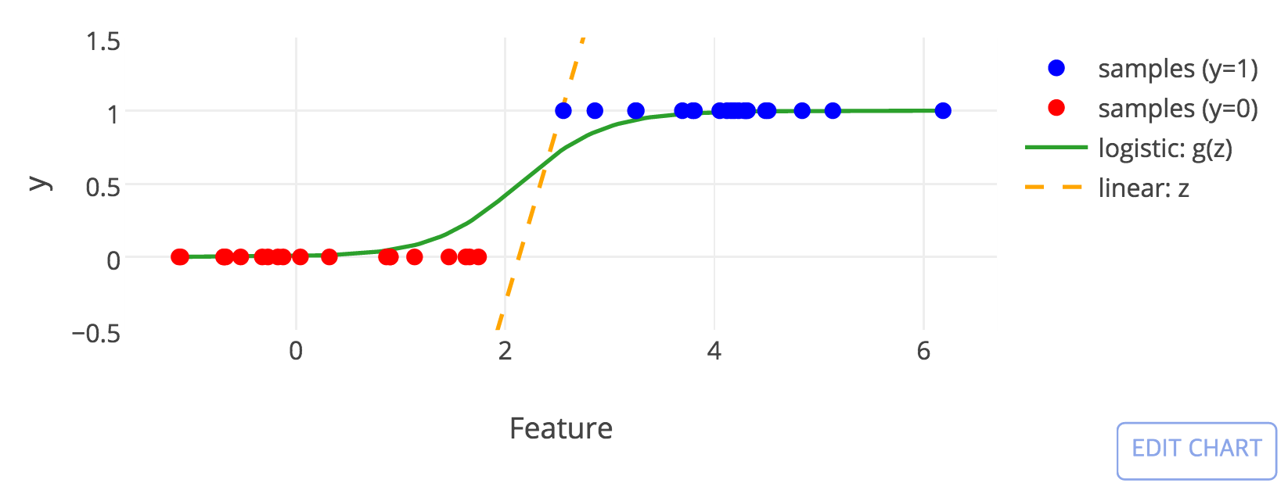
Logistic regression
Your first choice of machine learning methods

Slide 3
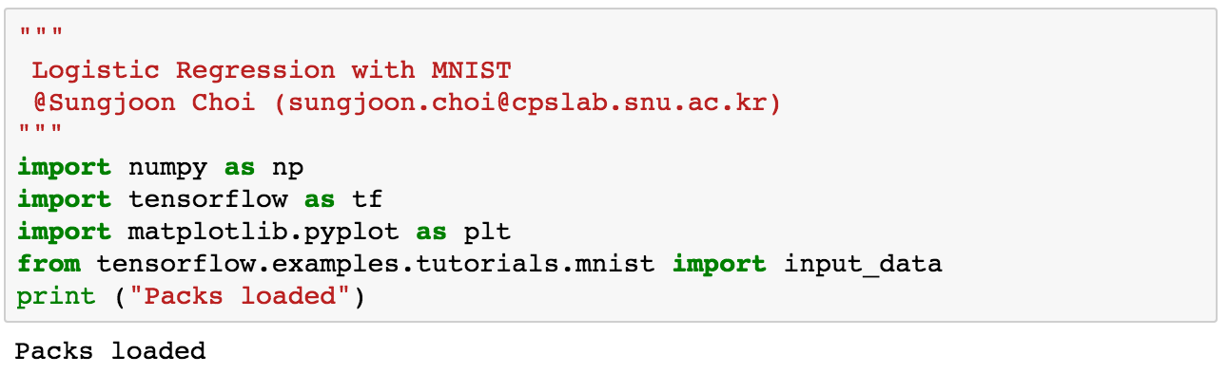
Packages

Slide 4
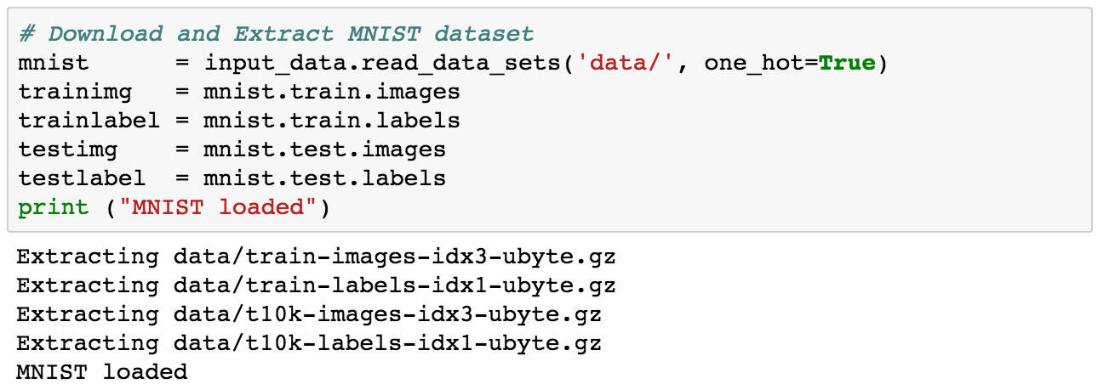
MNIST

Slide 5
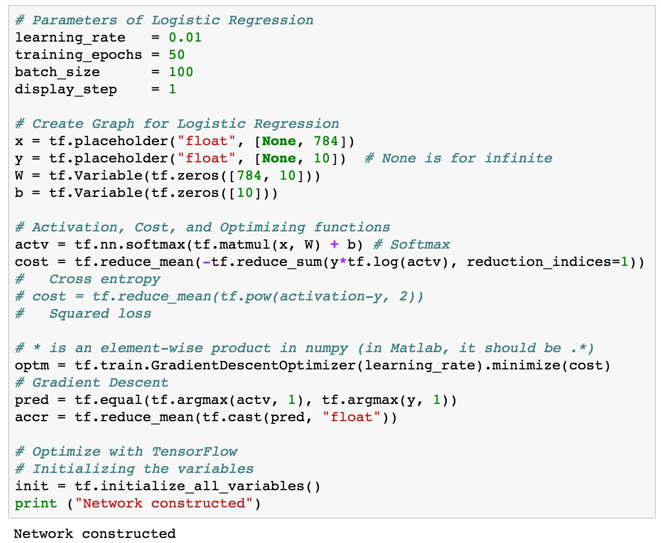
Construct nets

Slide 6
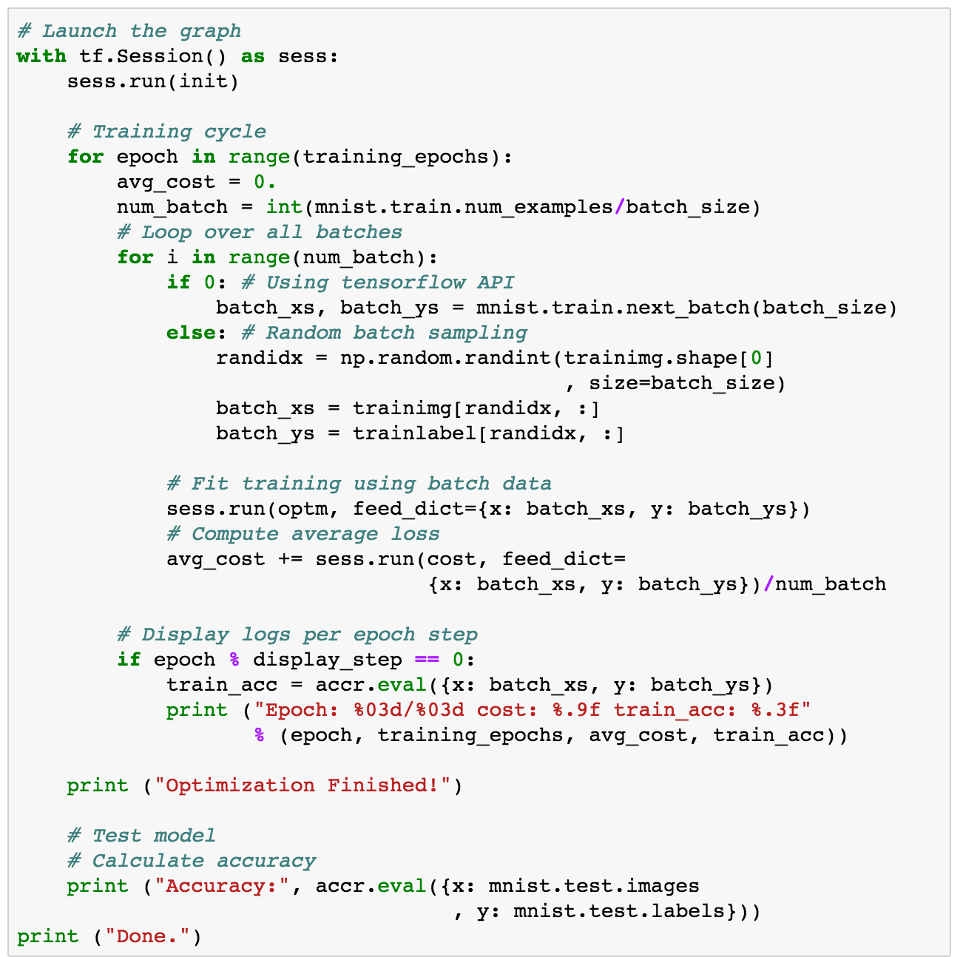
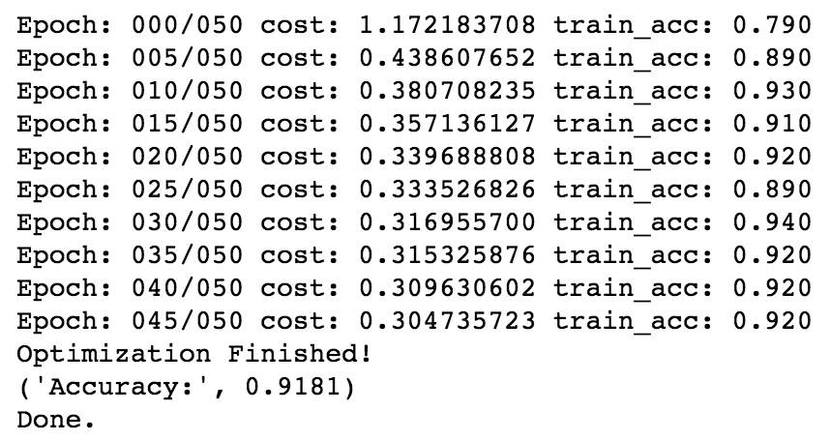
Run

Slide 7
How was it?

